Slide 1
MULTIPLE OFFICE CONNECTIVITY USING VPN
CN-mini project
by-
Gorle akhil
Soma Karthikeya
Pattapu Teja Sri

Slide 2
OBJECTIVE
So, this project is Multiple Office Connectivity which uses VPN technology to acheive the tasks like establishing the connection between them.
Here we are using the http, ftp and mail servers.
This connects the multiple branches of the same office together.
VPN establishes an encrypted channel that keeps a user’s identity and access credentials, as well as any data transferred, inaccessible to hackers.

Slide 3
FUNCTIONALITIES
Establish a secure private connection and safe connection for the data transfer between offices at multiple locations.
Web, mail, services and file transfer services.
The IPSEC performance can be improved by

Slide 4
Alternative Methodologies:
MPLS-There is no inherent encryption within MPLS. It is, simply, a traffic routing mechanism
SD-WAN- is designed to be a more efficient alternative to the VPN.SD-WAN offers more network connectivity flexibility.VPN tends to be more affordable than SD-WAN, due to its simplicity.

Slide 5
DESIGNING CONSTRAINTS
To enable IPsec VPN performance acceleration:
Enable VPN session affinity. ...
Enable IPsec performance acceleration. ...
Check your changes to the configuration before committing.

Slide 6
CLI COMMANDS
Access-list 100 permit ip 2.0.0.1 0.0.0.0.255 101.0.0.1 0.0.0.255
Crypto isakmp policy 10
Encryption aes 256
Authentication pre-share
Group 5
Crypto isakmp key secretkey address 14.0.0.1

Slide 7
Crypgto map IPSEC-MAP
Crypto ipsec transform-set R1->R3 esp-aes 256 esp-sha-hmac
Crypto map IPSEC-MAP 10 ipsec-isakmp
Set peer 14.0.0.1
Set pfs group5
Setsecurity-association lifetime 86400
Set transform-set R1->R3
Match address 100
Interface fa0/0

Slide 8
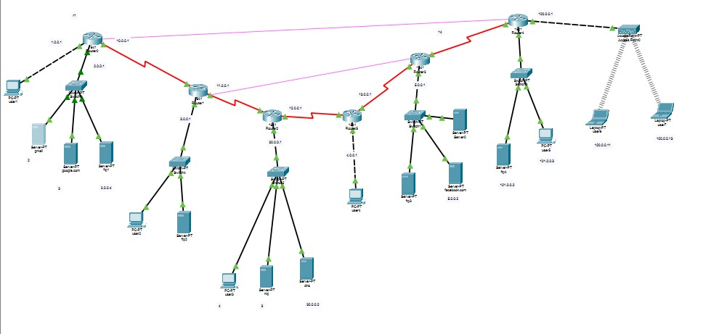
OUR NETWORK DESIGN MODEL

Slide 9
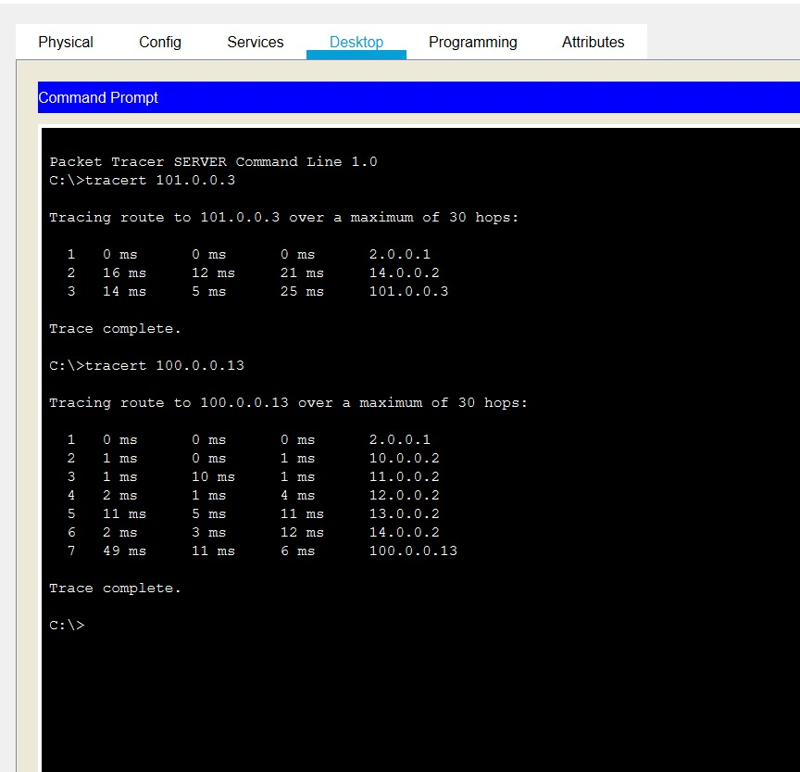
SHOWING VPN CONNECTION ROUTING

Slide 10
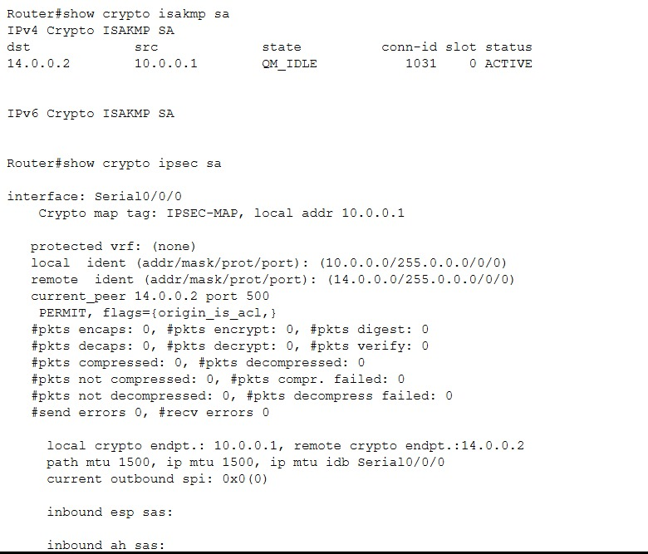
VALIDATION FOR IPSEC-VPN-

Slide 11
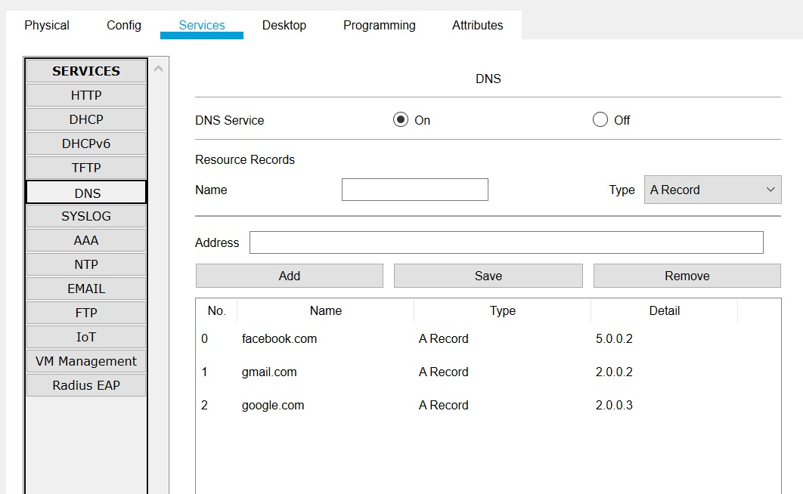
DNS

Slide 12
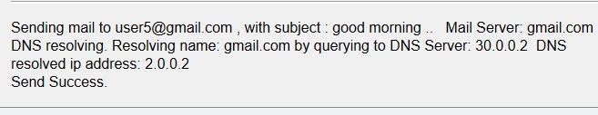
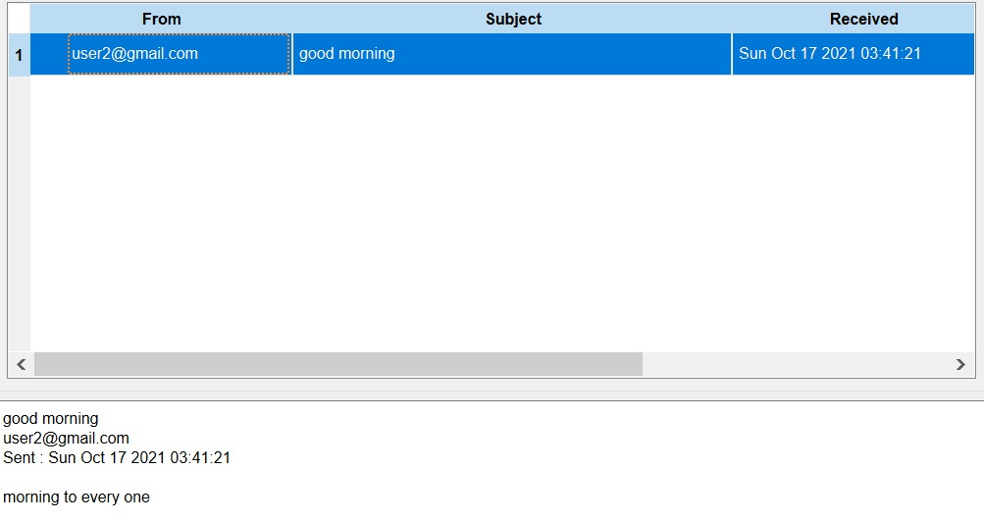
SEND AND RECEIVE FOR MAIL OPERATION:

Slide 13
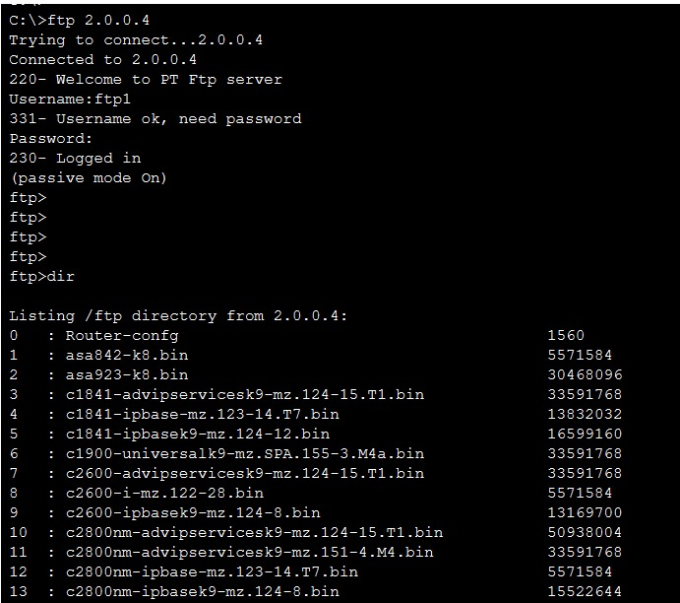
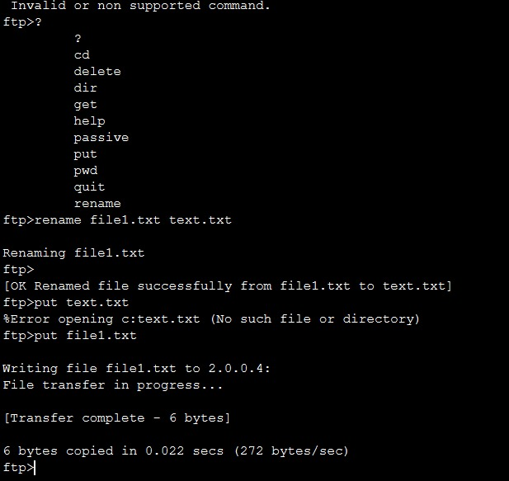
FTP SERVER CONNECTION

Slide 14
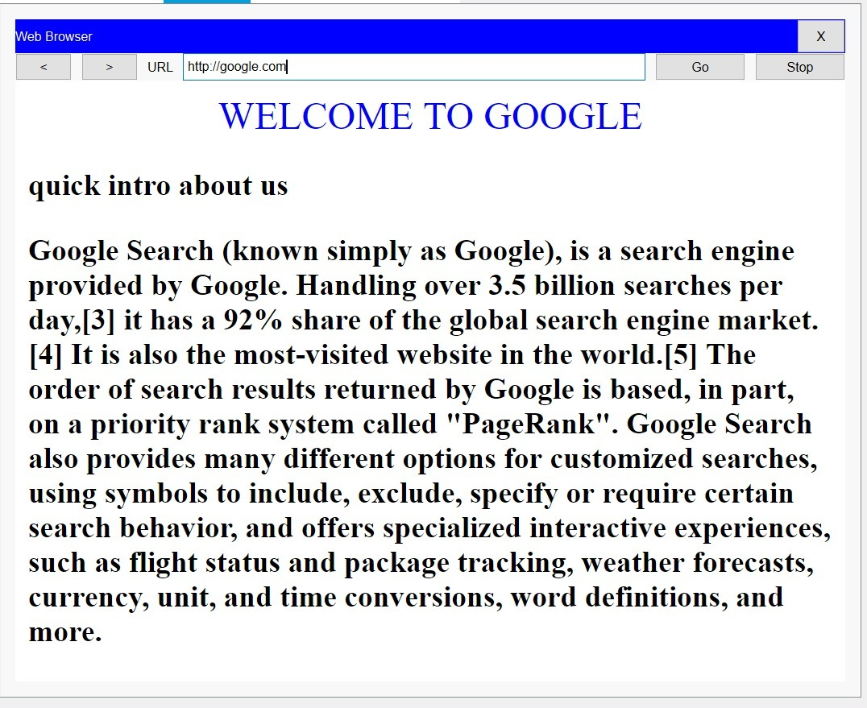
HTTP SERVER

Slide 15
THANKYOU:)

